Slide 1



AUTOMATION OF EGG HATCHERY SYSTEM WITH IoT
EMBEDDED SYSTEMS & IoT INTENSHIP
TEAM MEMBERS
PRIYANKA S - ECE III YEAR
PRIYAROSHINI R - ECE III YEAR
VISHNUPRIYAN R - ECE III YEAR
WINMATHI M - EEE III YEAR

Slide 2
01
Orgin of Idea
The place where the need and the right product begins to develop ……

Slide 3
Observed conditions
It is expensive to buy an incubator. Most of the incubators are highly priced and not affordable to small scale farmers.
Requires a lot of labour since there will be a lot of monitoring purposes.
It requires a lot of skills in order to manage and maintain an incubator
Automation and Realtime data monitoring can’t be done at affordable quotation as the client needs

Slide 4
02
Basics

Slide 5
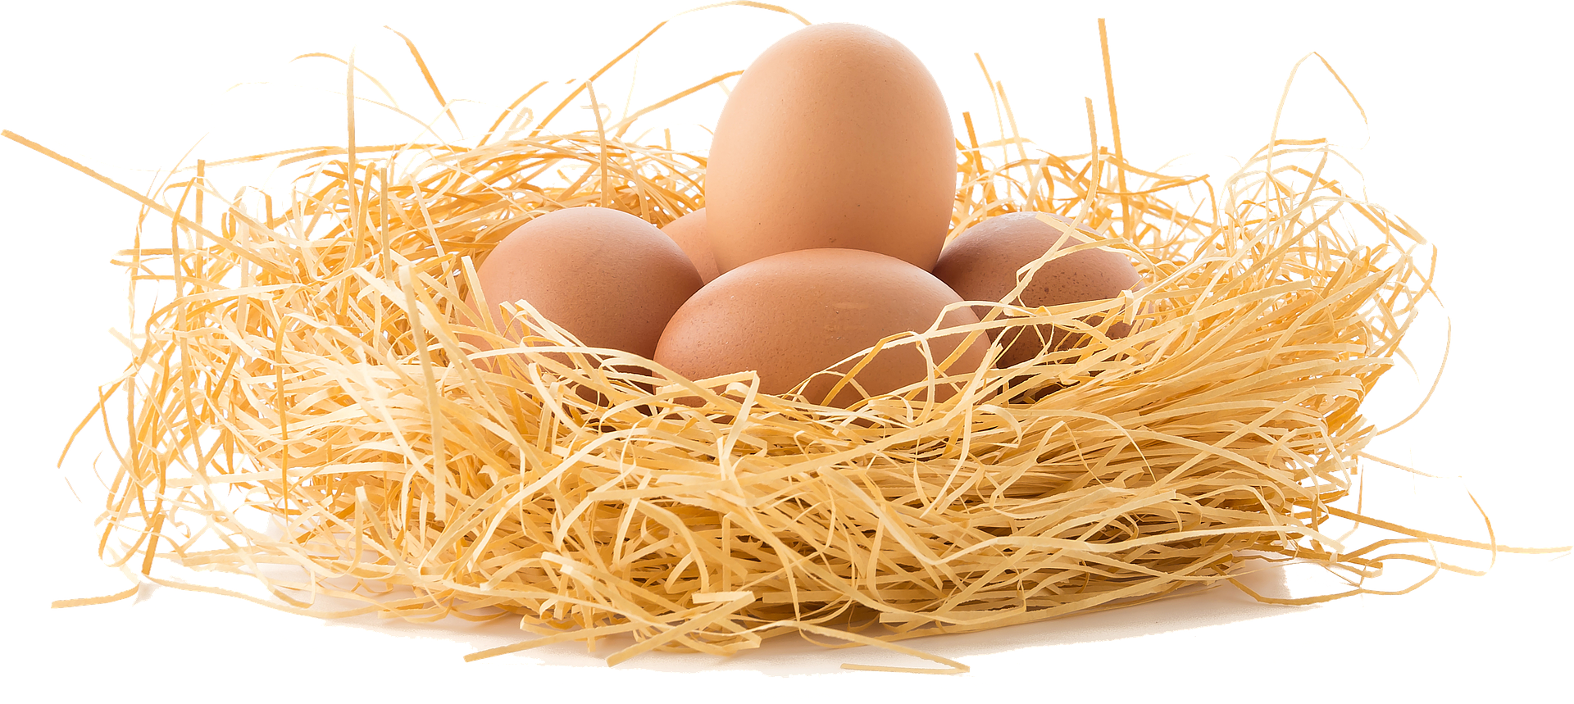



EGG INCUBATOR
EGG INCUBATOR
An incubator is a device simulating a incubation by keeping eggs warm at a particular temperature range and in the correct humidity with inclination mechanism to hatch them in certain period of time

Slide 6
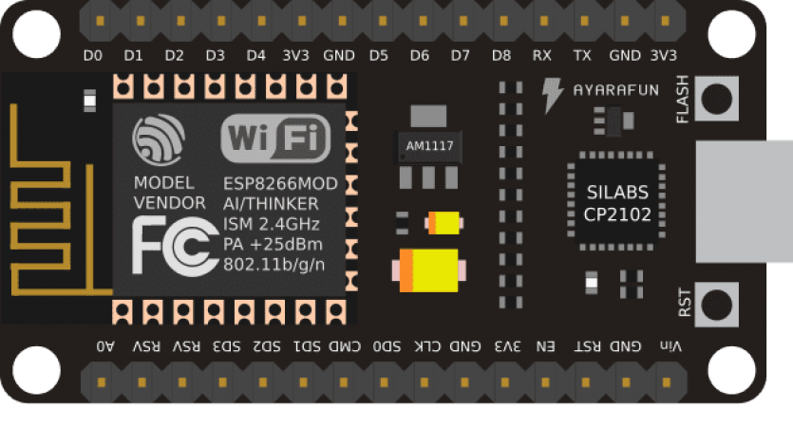
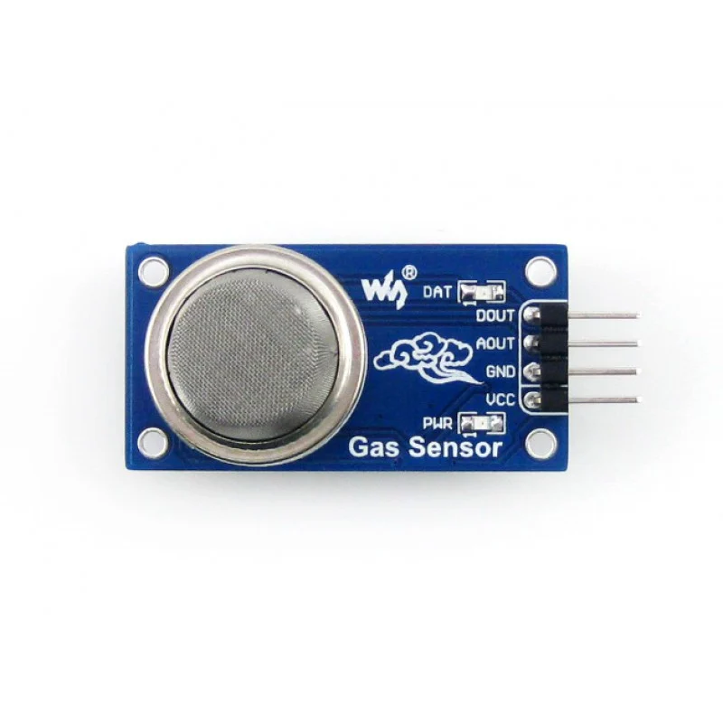
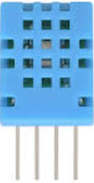

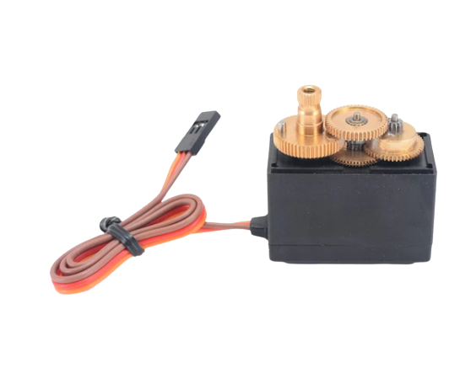
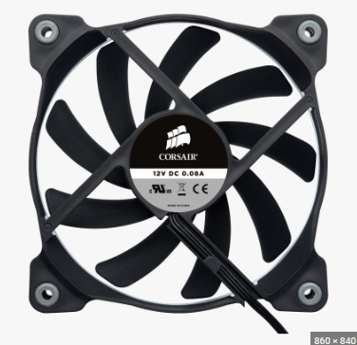
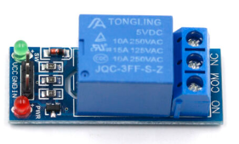
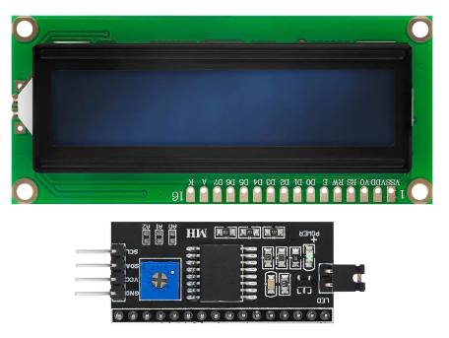
REQUIREMENTS
CONTROL DEVICES
MICROCONTROLLER
Relay (220 V)
Tungsten bulbs (50-60W)
DC 12v fan (*2)
I2C – 16 x 2 LCD display
Servo motor
SENSORS
Node MCU
MQ-2 Gas sensor
DHT-11 sensor

Slide 7
Node MCU
EPS8266 is incorporated as a Node MCU in an open source development program based on a widely used module.
The ESP8266 is an independent Wi-Fi module solution that provides seamless connectivity. It acts as a host or allows other host to be downloaded to the system.

Slide 8
DHT-11 Sensor
The DHT11 sensor is generally a temperature and humidity sensor that has an operating range between 3.3v to 5.5v
Temperature and humidity, being the main factors for healthy hatching, the DHT11 sensor plays a crucial role. The primary role is to quantify the temperature and humidity.

Slide 9
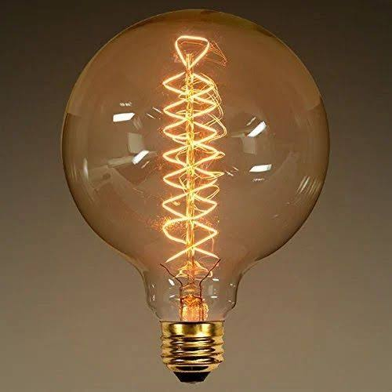
Tungsten bulbs (50-60W)
The incandescent lamp is used in place of power guzzler heating coils as they are relatively inexpensive and dramatically cuts down the running cost.
The lamps are also highly efficient since the heat generated by the incandescent lamps are adequate to heat up the incubator to sufficient temperatures.

Slide 10
03
Connections &Schematics
Repo: https://github.com/VISHNUPRIYANR1812/AoEH-Tessolve

Slide 11
BLOCK DIAGRAM
HARDWARE CONTROL NODE
RELAY-5v
220V -AC
INTERNET
API-KEY
T1
T2
TUNGSTEN BULBS
DC BRUSHLESS FAN
12V -DC
ANALYTICS NODE
DHT-11 SENSOR MODULE
Node MCU
SERVO PWM
MQ-2 GAS SENSOR
I2C
CLOUD MONITORING NODE
16 x 12 LCD
INTERNET
BLYNK IoT
LOCAL MONITORING NODE

Slide 12
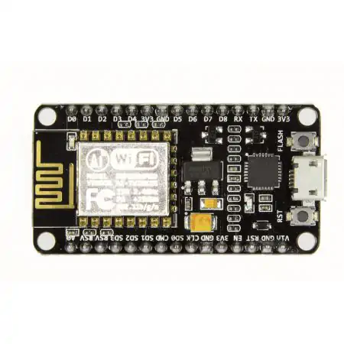
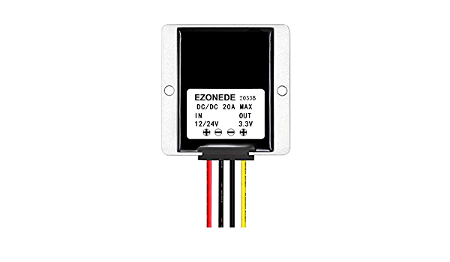
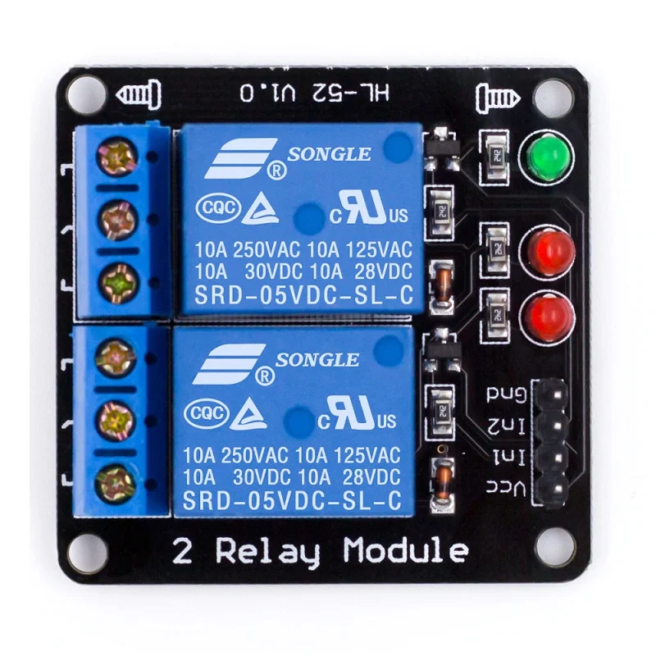

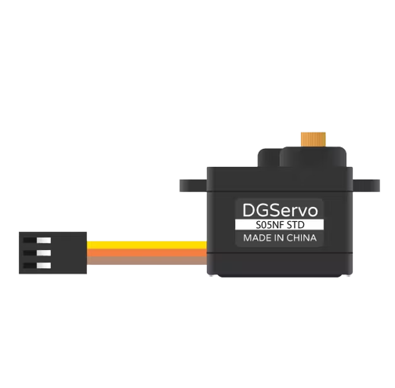
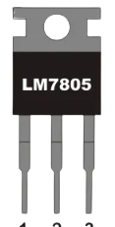
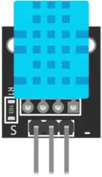

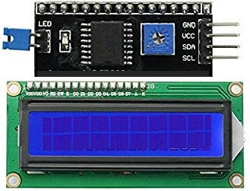
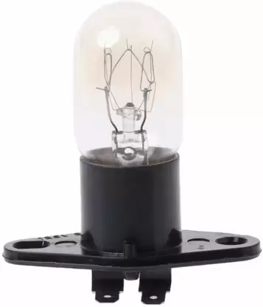
SCHEMATIC
DC-5V IN
AC-220V IN
Node MCU Lolin V3
AC-DC 12V ADAPTER
RELAY MODULE
HATCH-TRAY
MQ-2 GAS SENSOR
ST/LM-7805
-45*
+45*
SERVO-25G
DC-12V FAN
DHT-11 MOISTURE SENSOR
I2C-LCD MODULE
.90-W X 2 TUNGSTEN FILAMENTS

Slide 13
03
Applications & Future Scope

Slide 14
APPLICATIONS
Remote Monitoring and Control
Data Logging and Analysis
User-Friendly Interface and Visualization
Automatic Egg Turning
Notifications and Alerts
Enhanced Environmental Control

Slide 15
FUTURE SCOPE
Improving Hatch Rates: To make advanced control provided by the incubator ensures optimal conditions for egg development, resulting in higher hatch rates compared to natural incubation.
Enhanced Safety: The inclusion of cloud monitoring allows for monitoring and ensuring parameters within the incubator. This feature provides a safe and healthy environment for the eggs by detecting and alerting any potential gas leaks or hazardous conditions.
Automation and Convenience: By automating the egg turning process and enabling remote monitoring and control, the project reduces the need for manual intervention. This convenience saves time and effort for the user.

Slide 16
THANK YOU ALL

